Slide 1
Case Study in Value Acceleration

Slide 2


Our Presenter
Chris Snider, CEPA
Award-winning Author of Walking to Destiny, Creator of the Value Acceleration Methodology, 2017 AM&AA Thought of the Year, Managing Partner of Snider Premier Growth, CEO & President of the Exit Planning Institute

Slide 3
Learning
Objectives
After completing the session, participants will be able to:
Recognize value drivers which lead to increased value,
Implement a system to ensure these opportunities are harvested,
Determine how goals are being met and implement changes keep things on track.

Slide 4

A “Successful” Exit Strategy…
Maximizes the value of the business
Ensures you are personally and financially prepared
Ensures you have planned for the third act of your life

Slide 5
How Prepared Are We?
Exit Planning Institute’s State of Owner Readiness Survey 2013
2/3rds are not familiar with all exit options
78% have no formal transition team; 83% have no written transition plan; 49% have done no planning at all
Less than 7% have a formal life after plan
40% have no plans in place to cover illness, death or forced exit
1/2 feel ownership transition plans require the company to remain profitable, yet 86% have not taken on a strategic review or a value enhancement project
56% felt they had a good idea of what their business is worth yet only 18% have had a formal valuation in the last two years

Slide 6

Challenge #1
50% of exits are involuntary
Death
Disability
Divorce
Distress
Disagreement

Slide 7
Challenge #2
Owners are leaving $ on the table because they are focused on income generation; not focusing on enterprise value
Income does not automatically translate to value
Most businesses are not salable and do not make it through the second generation

Slide 8
Value Creation Process

Slide 9
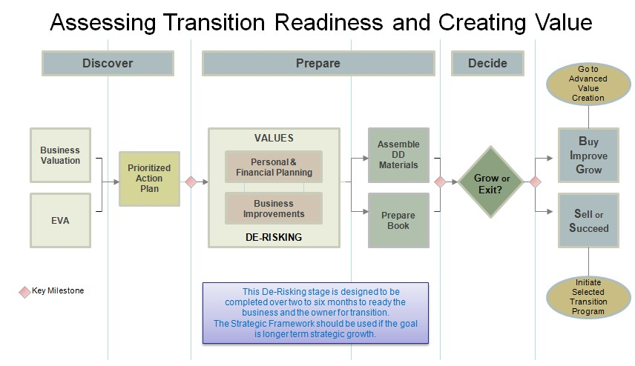
Overview of the Exit Planning Process

Slide 10
Value Acceleration Major Steps
Recast Income Statement and Balance Sheet
Complete financial analysis
Pull benchmarking data
  industry performance
  recent trade multiples
Complete an Enterprise Value Assessment (EVA) which scores the business attractiveness and the owner’s personal, financial and business readiness
Correlate the interview scores with the business valuation and financial analysis
Deliverable:
  A specific and qualified list of personal, financial and business strengths and weaknesses
  Correlated and used to justify present value and potential value
  To establish a $ Value with regard to what value enhancement is worth
Prioritized Action Plan is created
  Personal / Financial Actions
  Business Actions
Which will be implemented in 90-Day “Sprints” (Interval Training)

Slide 11
Suggested 90-Day Next Steps
DELAY THE DECISION
VALUATION & STRATEGIC ASSESSMENT
ROADMAP & BENEFITS
DE-RISK FIRST
TIME & MONEY
GROW OR TRANSITION?

Slide 12

Overview of the Exit Planning Process
DELAY THE DECISION
VALUATION & STRATEGIC ASSESSMENT
ROADMAP & BENEFITS
DE-RISK FIRST
TIME & MONEY
GROW OR TRANSITION?

Slide 13
Financial Analysis & Business Valuation

Slide 14
Recasted Income Statement of Company X
Recasted Income Statement 20XX-20XX | 20XX | 20XX | 20XX | 3 Year Average |  | Sample Average
Sales | 3,748,404 | 4,321,732 | 4,944,224 | 4,338,120 |  | 4,944,224
% Increase-Decrease | na | 15.30% | 14.40% | na |  | na
Cost of Sales | 2,304,820 | 2,777,417 | 3,430,356 |  | 2,837,531 | 3,065,419
% Sales | 61.49% | 64.27% | 69.38% |  | 65.41% | 62.00%
Gross Profit | 1,443,584 | 1,544,315 | 1,513,868 |  | 1,500,589 | 1,878,805
% Sales | 38.51% | 35.73% | 30.62% |  | 34.59% | 38.00%
Operating Expense | 621,111 | 645,985 | 664,761 |  | 643,952 | 870,108
% Sales | 16.57% | 14.95% | 13.45% |  | 14.84% | 17.60%
Officer Compensation | 450,000 | 450,000 | 450,000 | 450,000 |  | 450,000
% Sales | 12.01% | 10.41% | 9.10% | 10.37% |  | 9.10%
Total Operating Expense | 1,071,111 | 1,095,985 | 1,114,761 | 1,093,952 |  | 1,320,108
% Sales | 28.58% | 25.36% | 22.55% | 25.22% |  | 26.70%
EBITDA | 372,473 | 448,330 | 399,107 | 406,637 |  | 558,697
% Sales | 9.94% | 10.37% | 8.07% | 9.37% |  | 11.30%

Slide 15
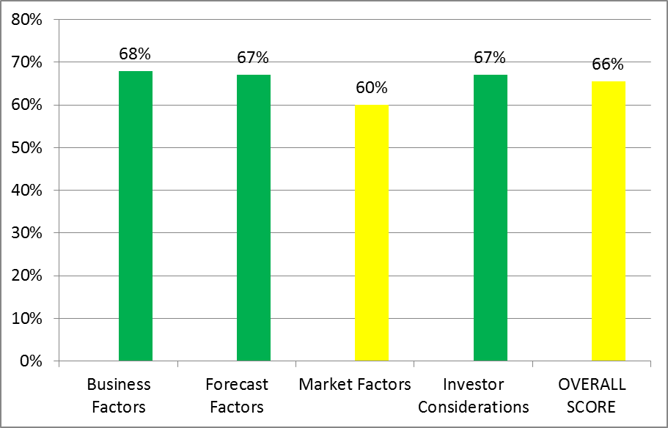
Business Attractiveness Score: 25 Questions in 4 Categories
ATTRACTIVENESS SCORES
Business Factors | Score | 68%
Forecast Factors | Score | 67%
Market Factors | Score | 60%
Investor Considerations | Score | 67%
OVERALL SCORE |  | 66%
PREMIUM:72%+
MID: 51%-72%
DISCOUNT: 50% OR LESS
Goal: 67%

Slide 16
Business Factors | 1=No t Good 6=Good 0= NA | 1 | 2 | 3 | 4 | 5 | 6
Years of business operation | 5 |  |  |  |  | X |  | 22 years in business
Management strength | 3 |  |  | X |  |  |  | No clear #2. Just promoted a few into management positions.
Customer loyalty | 5 |  |  |  |  | X |  | Have letters from customers, "Raving Fans". Feel very strongly about this.
Brand awareness | 3 |  |  | X |  |  |  | Other vendors, i.e. Comp2 but not probably the average guys on the street. Employees should have clarity of w ho w e are. Tried to build coalition of alliance partners.
Good customer base (not concentrated) | 3 |  |  | X |  |  |  | Diverse customer base from an industry standpoint.. Financial concentration #1 Customer 29% 20XX; 34% May 20XX. Top 10 make up 71% of sales. 15 customers make up 80%. 94 customers as of May 20XX.
Packaged IP & Technology | 5 |  |  |  |  | X |  | Workflows developed for managed services
Key staff longevity | 4 |  |  |  | X |  |  | Dave 15, Mike Mgr 6, Carmen Mgr 4
Location | 7 |  |  |  |  |  |  | nice headquarters, but not realy applicable. Not an issue for a strategic buyer
Non reliance on key manager(s) | 4 |  |  |  | X |  |  | Would not be an issue for a strategic buyer. Non dislcousures, not competes w ith employees and clients. Focus on selling as a team.
Replicatable business model | 3 |  |  | X |  |  |  | Execution is really the key to success, not the model itself.
Business systems and process | 3 |  |  | X |  |  |  | Have them but need to get them packaged
68%

Slide 17
Forecast Factors | 1 = Not Good 6 = Good 0 = NA | 1 | 2 | 3 | 4 | 5 | 6
Profitability past/present | 3 |  |  | X |  |  |  | GM has been falling even though sales are up
Profitability grow th forecast | 3 |  |  | X |  |  |  | profit flat last three years. Actually dow n from last year. Below market as a % to Sales
Revenue grow th | 5 |  |  |  |  | X |  | last three years appears to be solid
High certainty in budget | 4 |  |  |  | X |  |  | Consistent historical top line grow th but do not do any formal forcasting
Recurring revenue model | 5 |  |  |  |  | X |  | last three years appears to be solid. Needs to be a real significant reason to sw itch
67%
Market Factors | 1 = Not Good 6 = Good 0 = NA | 1 | 2 | 3 | 4 | 5 | 6
Market grow th & potential | 4 |  |  |  | X |  |  | this industry is strong right now
Industry barriers to entry | 3 |  |  | X |  |  |  | High investment: No. Credit lines needed. Must be vendor qualified.
Competitive activity or advantage | 4 |  |  |  | X |  |  | Not w orried about it. How many customers lost in the last three years?
Dominant market position | 3 |  |  | X |  |  |  | Lots, very fragmented. Don't really know .
Economic prosperity | 4 |  |  |  | X |  |  | Economy getting better. Banks lending more; like this industry
60%

Slide 18
Investor Considerations | 1 = Not Good 6 = Good 0 = NA | 1 | 2 | 3 | 4 | 5 | 6
Reason for selling | 4 |  |  |  | X |  |  | Ready to change direction. Retirement would be better.
Synergy and value add of buyer | 4 |  |  |  | X |  |  | Employees would not have to be retained per se. Location could go away.
Degree of risk | 4 |  |  |  | X |  |  | Strong
Market for business sale | 4 |  |  |  | X |  |  | Strong
67%

Slide 19

Exit Readiness Score: 121 Questions in 22 Categories
EXIT READINESS SCORE
Company Documentation | 38% | Discount | Corp book, oper agmt, procedures doc, ISO/SOC
Credibility and Justification | 47% | Discount | Customer list, testmonials, awards, case studies
Expense Contracts | 50% | Discount | Suppliers, leases, insurance, web, etc.
Intellectual Property | 42% | Discount | Trademarks, patents, software, domains
Management Systems and Forecasts | 39% | Discount | 12 months - 3 years, scorecard
Marketing Documentation and Systems | 50% | Discount | Systematic, proof
Payment Considerations | 50% | Discount | Needs vs Wants, Net proceeds, Exit Options
Shareholder Goals | 44% | Discount | Shareholder Alignment when how who, buy-sell
Customer Contracts | 56% | Below goal | Customers & strategic alliances, warranties, maint.
Employee and Management Issues | 57% | Below goal | Reliance, competency, morale, P&P, turnover
Financials | 64% | Below goal | Taxes, mgmt reports, customer analysis
Personal Expectations | 57% | Below goal | sustainable lifestyle, life after plans, contingency
Product & Marketing Strategies | 58% | Below goal | new & existing products and markets
Revenue Drivers | 60% | Below goal | S&M, lead generation, conversion, conversion rate
Brand Issues | 70% | Meets Goal | Does the brand add value?
Profit Improvement | 69% | Meets Goal | SGA, insurance, banking, cash, payroll, GM, payroll
Immediate Value Readiness | 69% | Meets Goal | How ready right now? Expections realistic?
Personal Knowledge | 67% | Meets Goal | Transition vision, unplanned events, educated?
Valuation Expectations | 70% | Meets Goal | Valuation, Value Enhancement, and timeframe
Compliance Issues | 83% | Premier | Taxes, environmental, regulatory, retirement
Systems Processes and Databases | 79% | Premier | CRM, Accounting, fulfillment, mfg/dist, etc.
Look at Government Grants | NA | NA | R&D, fed, State, Local
OVERALL SCORE | 55% | Below goal
PREMIUM:72%+
MID: 51%-72%
DISCOUNT: 50% OR LESS

Slide 20
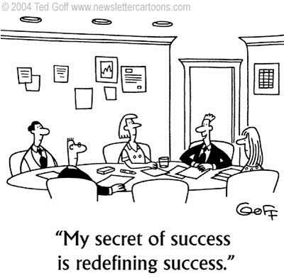
Summary
Gross Profit of 31%; Industry average 38%.
EBITDA 8% to Sales below sample average of 11%; Best in Class 18%;
Scored below goal on 58 of 121 questions.
Discount level in 8 of 22 categories

Slide 21
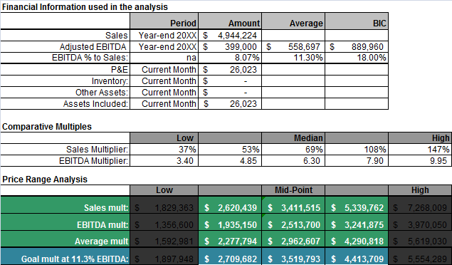

Business Value and Benchmarks
HOW MUCH VALUE ARE YOU LEAVING ON THE TABLE?

Slide 22
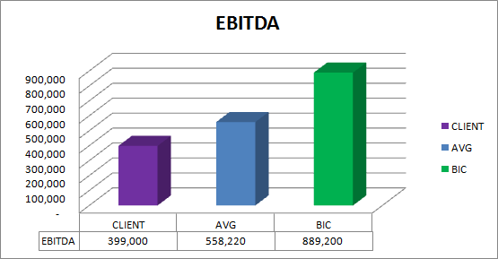
Profit Gap: How much more EBITDA?
@8%
11%
18%
+ $490,000
+ $159,000

Slide 23
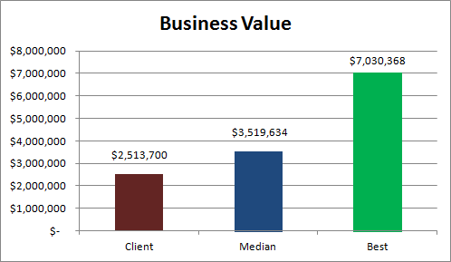
Value Gap: How much more value?
Best in Class Multiple: 7.90
Median Multiple: 6.30
40% or $1M increase in enterprise value at industry average EBITDA
180% or $4.5M
increase in enterprise value if operating at Best in Class
Ind. Avg.
11%
EBITDA:
@8%
18%
Assumes $4,944,000 in gross sales

Slide 24
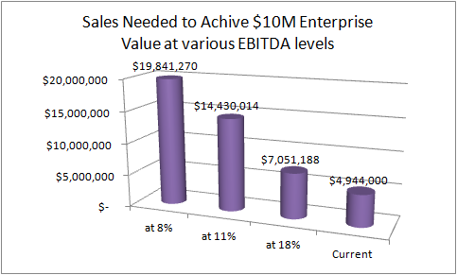
Sales Need to Achieve $10M Valuation
At current performance level
Almost $20 million in sales needed to achieve the partners exit value objective of $10 million.
$14.4 million in sales needed at average EBITDA
$2.1M in sales needed if operating at BIC level
EBITDA % to Sales

Slide 25
Creating and Implementing Action Plans

Slide 26
Why not aim to be Best In Class?

Slide 27
From this…
CATEGORY | TOPIC | ACTION | COMMENTS | SCORE
Valuation Expectations | Knowledge business valuation | Determine a rough estimate of what your business is worth today. | think $1,000,000+ dollars but not really sure. We are doing BV | 50%
Valuation Expectations | Satisfied with valuation | Determine whether you would be satisfied with the amount of money that your business would be worth today. | Only if this is FMV | 67%
Valuation Expectations | Improve business worth | Implement strategies to improve your business worth before placing the business on the market. | Some subtle changes | 67%
Valuation Expectations | Time frame | Develop a time frame to sell the business. | End of the year. Would like more time to prep but may not be necessary | 67%
Valuation Expectations | Handover transition | Determine the transitional period (or time available to consult to the new business owner) that you would be prepared to offer a potential buyer. | 6-12 months | 67%
Personal Expectations | Activities after sale | Determine what you will do after you sell the business. | not really. Will most likely need to supplement income. Needs to think about this and put a plan together | 50%
Personal Expectations | Sustainable lifestyle | Calculate whether you will be able to sustain the proposed "post acquisition lifestyle" based on what the business is worth now. | Income will need to be supplemented | 50%
Personal Expectations | Actual needed to Sustain | Calculate the amount of money you would actually need to achieve your lifestyle objective | No. | 33%
Personal Expectations | Timing of forced Retirement | Determine whether there is a time that you need to retire or exit the business. | Not being forced to sell | 67%
Personal Expectations | Vision for the Business | Determine whether you wish to have a vision for the business after you sell it and if so what this vision would be. | I want the business to continue to grow and prosper | 83%
Shareholder Goals | Shareholders | Print a list of the names and addresses of all the shareholders in the business. | Three shareholders. Two are very small minority. "They don't need to know." No legal obligation? We should follow up on this. | 83%

Slide 28
Sample Personal/
Financial Actions
Personal goals and objectives
Meet with family members
Financial plan / Needs vs. Wants
Exit options analysis
Deal structure
Tax planning
Net proceeds analysis
Estate planning
Contingency plan
Life-After plan
Formalize advisory team / board

Slide 29
Business Actions
Key employee situations
Management succession plans
Performance reviews / Employee manual
Customer diversification / analysis / contracts
Metrics and Dashboard
Start-Stop Workshop
Records inventory / management
Financial Recast and Business Valuation
Inventory and Physical assets
Back office systems and processes

Slide 30
Setting Priorities
Strategic vs Non Strategic Ves
De-Risk First
  Unplanned events
  Insurance
  Contingency planning
Set Goals and Objectives
Financial Planning & Life After Planning
Business Efficiency (business model)
Marketing and Growth (strategic)
Culture / Talent Development

Slide 31
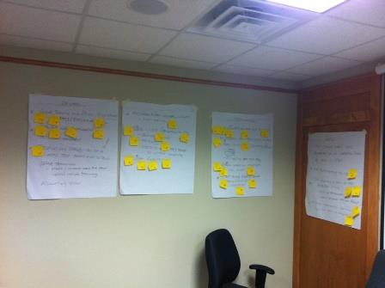
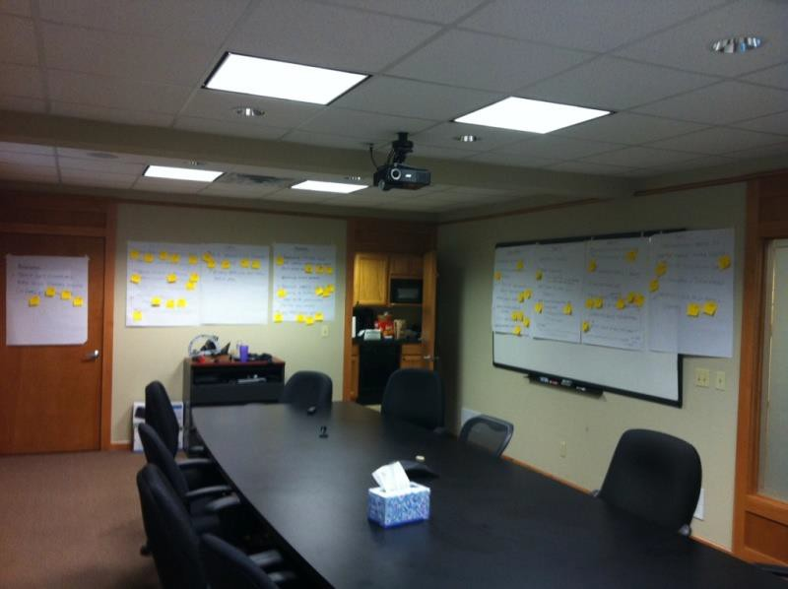
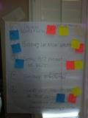
Workshops NOT Meetings
Write it down & follow up!

Slide 32
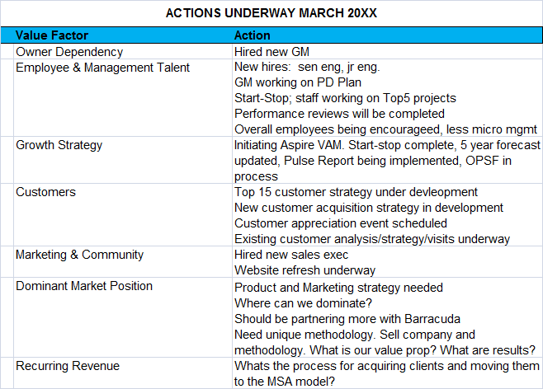
Non-Financial Reporting

Slide 33
Financial Reporting
Revenue
Headcount
$3,500,000
$3,000,000
$2,500,000
$2,000,000
$1,500,000
$1,000,000
$500,000
$-
25
20
15
10
5
0
Jun-11
Sep-11 Dec- 11
Mar- 12 Jun-12 Sep-12 Dec- 12
Mar- 13 Jun-13 Sep-13 Dec- 13
Mar- 14 Jun-14 Sep-14 Dec- 14
Mar- 15 Jun-15 Sep-15 Dec- 15
Jun-11
Sep-11
Dec- 11
Mar- 12 Jun-12 Sep-12 Dec- 12
Mar- 13 Jun-13 Sep-13 Dec- 13
Mar- 14 Jun-14 Sep-14
Dec- 14
Mar- 15 Jun-15 Sep-15 Dec- 15
Revenue - Dept A
Revenue - Dept B
Headcount
Profit / Dividend
Margin / Div Ratio
$1,200,000
$1,000,000
$800,000
$600,000
70%
60%
50%
40%
30%
20%
10%
0%
$400,000
$200,000
$-
Jun-11
Sep-11
Dec- 11
Mar- 12 Jun-12 Sep-12 Dec- 12
Mar- 13 Jun-13 Sep-13 Dec- 13
Mar- 14 Jun-14 Sep-14 Dec- 14
Mar- 15 Jun-15 Sep-15 Dec- 15
Jun-11
Sep-11
Dec- 11
Mar- 12 Jun-12 Sep-12 Dec- 12
Mar- 13 Jun-13 Sep-13 Dec- 13
Mar- 14 Jun-14 Sep-14 Dec- 14
Mar- 15 Jun-15 Sep-15 Dec- 15
Net Profit
Dividend
Net Margin
Div payout ratio

Slide 34
Creating and Implementing Action Plans

Slide 35
$9,000,000
$8,000,000
$7,000,000
$6,000,000
$5,000,000
$4,000,000
$3,000,000
$2,000,000
$1,000,000
$0
3.82
4.26
4.50
5.50
6.73
7.97
9.20
Sales
Cost of Sales
Gross Margin
EBITDA
Value
Year | Yr 0 | Yr 1 | Yr 2 | Yr 3 | Yr 4 | Yr 5 | Yr 6
Multiple | 3.82 | 4.26 | 4.50 | 5.50 | 6.73 | 7.97 | 9.20 | Improvment | Improvment
Sales | $1,970,462 | $2,007,566 | $2,107,944 | $2,213,342 | $2,324,009 | $2,440,209 | $2,562,219 | 30% | $591,757
Cost of Sales | $1,161,098 | $1,174,646 | $1,189,650 | $1,200,922 | $1,207,816 | $1,209,607 | $1,205,481 | 4% | $44,383
Gross Margin | $809,364 | $832,920 | $918,294 | $1,012,419 | $1,116,192 | $1,230,602 | $1,356,739 | 68% | $547,375
Expenses | $468,857 | $506,407 | $566,407 | $503,878 | $502,618 | $501,362 | $500,108 | 7% | $31,251
EBITDA | $340,507 | $326,513 | $351,887 | $508,541 | $613,574 | $729,240 | $856,630 | 152% | $516,124
Value | $1,300,000 | $1,390,945 | $1,499,040 | $2,794,435 | $4,129,353 | $5,808,399 | $7,881,000 | 506% | $6,581,000
Years 2-5: 5% CAGR, 5% reduction in expenses, 5% improvement in GM

Slide 36
350%
300%
250%
200%
150%
100%
50%
0%
3.82
4.26
4.50
5.50
6.73
7.97
9.20
Cost of Sales
Gross Margin
Expenses
EBITDA
Value
Year | Yr 0 | Yr 1 | Yr 2 | Yr 3 | Yr 4 | Yr 5 | Yr 6
Ratios | 3.82 | 4.26 | 4.50 | 5.50 | 6.73 | 7.97 | 9.20
Cost of Sales | 59% | 59% | 56% | 54% | 52% | 50% | 47%
Gross Margin | 41% | 41% | 44% | 46% | 48% | 50% | 53%
Expenses | 24% | 25% | 27% | 23% | 22% | 21% | 20%
EBITDA | 17% | 16% | 17% | 23% | 26% | 30% | 33%
Value | 66% | 69% | 71% | 126% | 178% | 238% | 308%
EBITDA Industry Average 15%; Best In Class 23%

Slide 37
Implementation is the Key that Unlocks Value Creation
How things get done!
Have a vision and define 3-5 year capabilities that need to be developed to achieve it;
Focus on the next year and next quarter. Set one year and next 90-Day Business and Personal goals and priorities;
Separate De-Risking vs. Strategic. Focus on De-Risking first.
Align the team. Assign accountability. Commit resources.
Establish a measurement and feedback process. Individual and company dashboards.
Define a rhythm: Daily huddles, weekly project progress (tactical), monthly management (more strategic, quarterly accountability (planning and recalibrate)
REVISIT STEP ONE EVERY 90 DAYS

Slide 38
Delivering innovative learning experiences, performance-enhancing resources and strategic tools designed to enhance the exit planning profession

